Slide 1
Wine Recommender System
By: Shane Nelson, Allie Schneider, Francis Villamater, Will Wu
Notes:
Allie

Slide 2

Project Description
Create a wine recommender system
Wine discovery
Guidance and education
Grape varieties, regions, and styles
Notes:
Allie

Slide 3
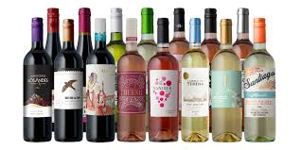
Project Goals
Aid users in:
Understanding the complexities of wine
Learning about wine and the user’s palate for wine
Finding new wines to try
Notes:
Allie

Slide 4
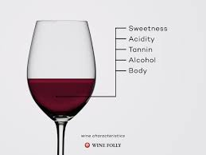
Project Goals
Content-Based System
Characterize qualities
Predict ratings
Provide recommendations
Knowledge-Based System
User inputs qualities
System provides related wines
Case-Based Knowledge recommender
Notes:
Allie

Slide 5
Benefits of Project
Potential to expand the wine market and increase wine sales
Yields a tool for improved inventory management
Generates an enhanced customer satisfaction
Creates for a more manageable process of discovering and learning about wine
Provides personalized wine recommendations
Benefits both wine novices and wine sommeliers
Notes:
Will

Slide 6
Potential Stakeholders of Project
Novice Wine Consumers
Cultivate a better understanding of the user’s palate for wine
The system can aid in finding new wines to enjoy
Offers insights into different grape varieties, regions, and styles
Provide guidance and education that will help in understanding the complexities of wine
Wine Sommeliers
The system can be used to expand the breadth of the user’s experiences
Serve as a valuable tool for discovering new and obscure wines
Expand the user’s knowledge beyond the existing repertoire
Bring to light different perspectives and suggestions
Notes:
Will

Slide 7
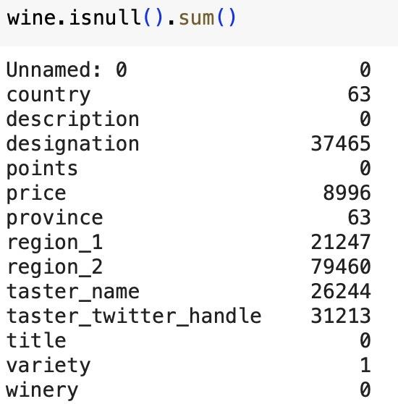
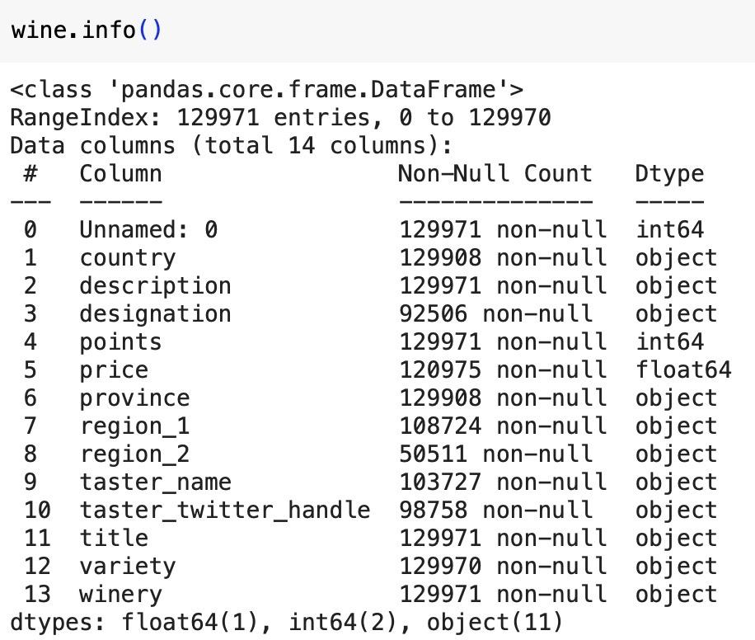
EDA - Initial Data Cleaning & Analysis
Load into Pandas Dataframe
11 potential predictor features:
10 categorical, 1 numeric
1 target feature: Points
Drop obviously unhelpful columns: taster_twitter_handle, unnamed: 0
Drop duplicate reviews (subset taster_name and title)
118,971 unique reviews
Notes:
Francis

Slide 8
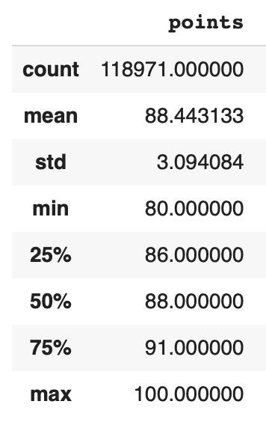
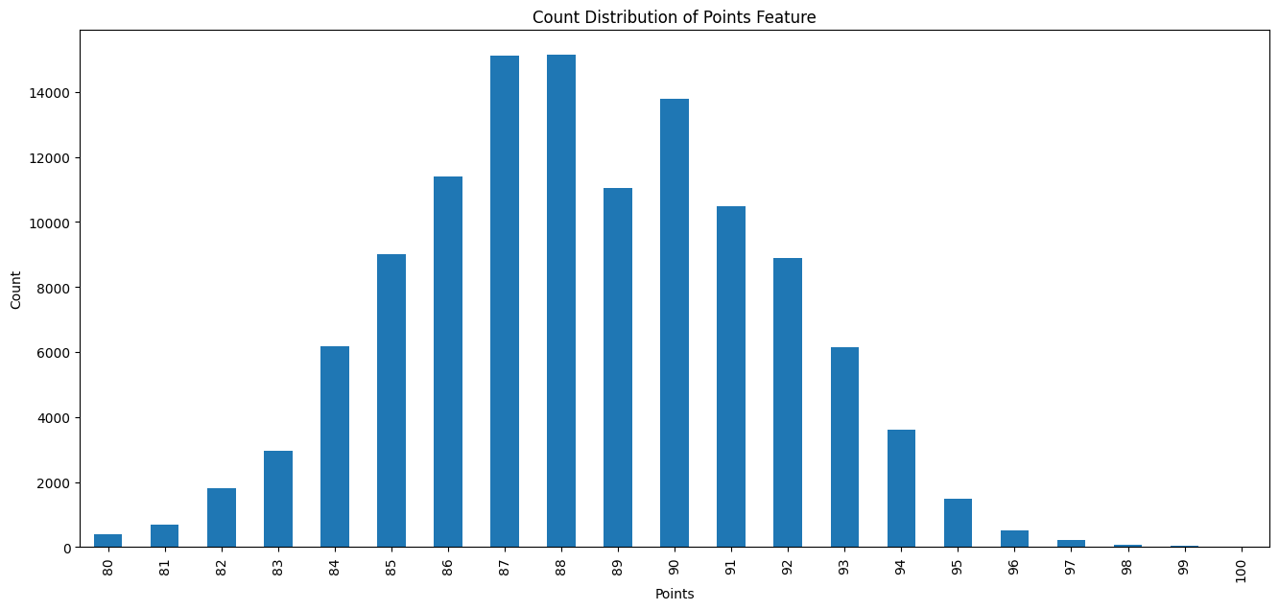
Target Feature - Points
Close to normal distribution; Range could be improved for interpretability
Notes:
Francis

Slide 9
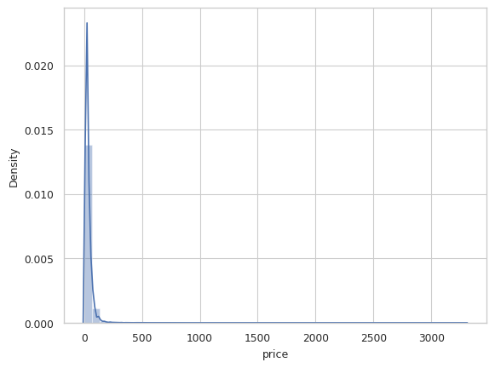
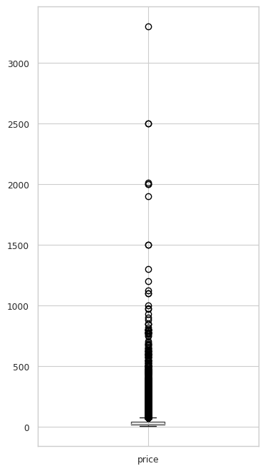
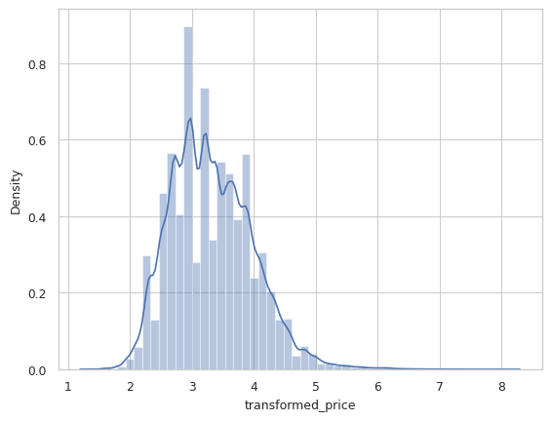
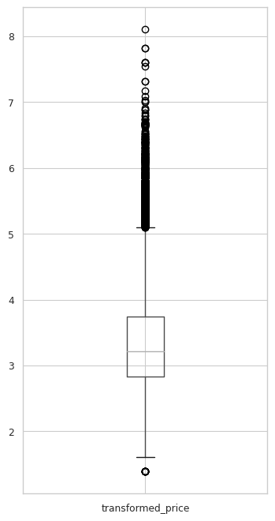
Price
Initially skewed → Log transformation helps
0.62 Pearson Correlation with Points after transformation (strong, positive relationship)
Pre-Transformation
Post-Transformation
Notes:
Francis

Slide 10
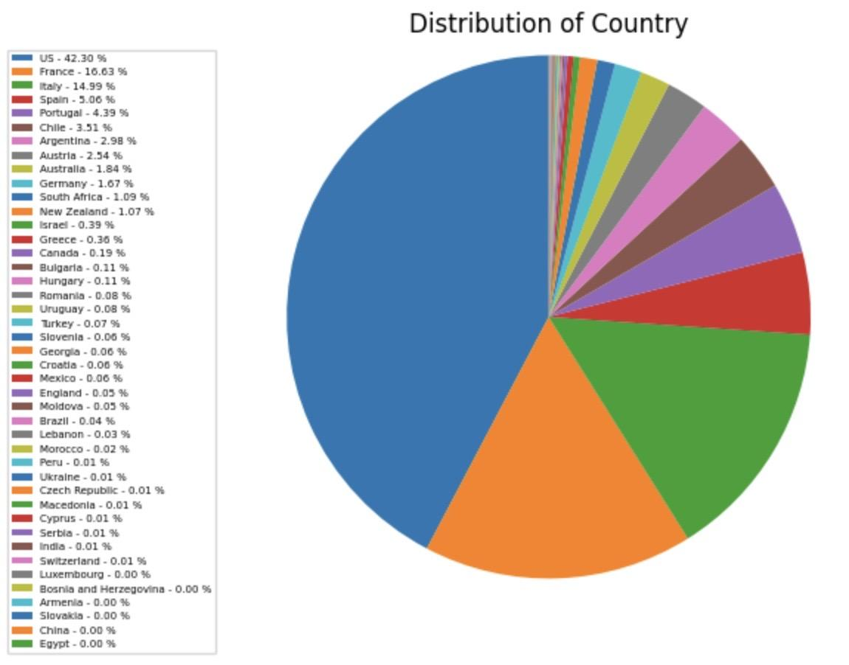
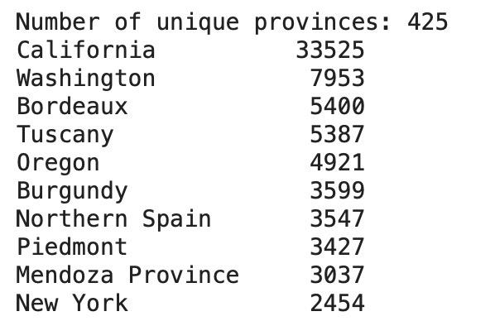
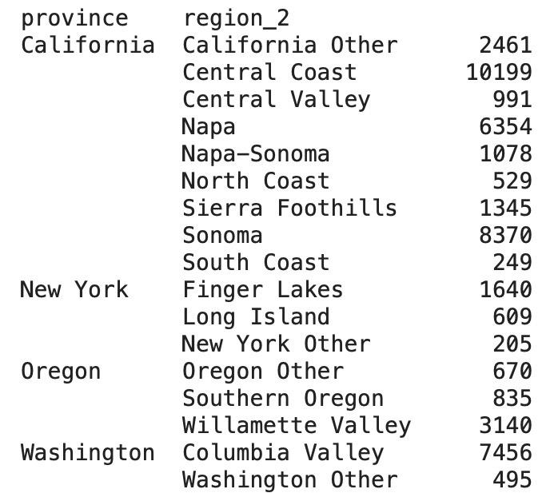
Country, Province, Region
Country & Province - Dominated by USA & California:
Region_1 - Too many unique (>1,200)
Region_2 - Subcategory of 4 Provinces: California, Washington, Oregon, New York
Creating new Location feature would be beneficial
Notes:
Francis

Slide 11
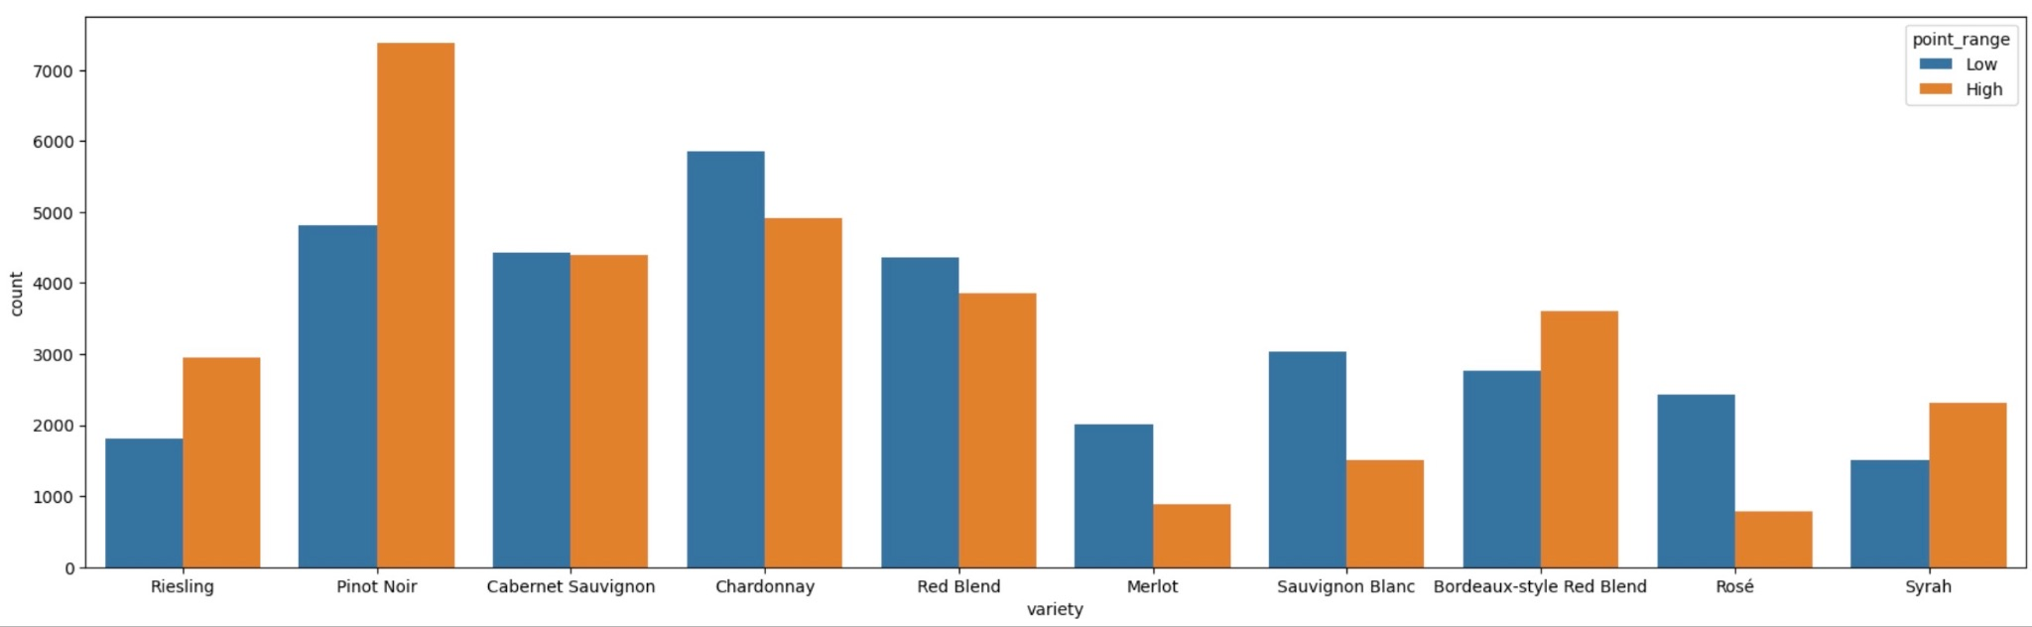
Remaining Features
Points Distribution of Top 10 Varieties
Variety:
Overall clean column
Arguably the top identifying feature of a wine
Description:
User-submitted
Could be used as a ‘keyword’ for constraint-based recommender
“Aromas include tropical fruit, broom, brimstone and dried herb. The palate isn't overly expressive, offering unripened apple, citrus and dried sage alongside brisk acidity.”
↓
[aromas, include, tropical, fruit, broom, brimstone, dried, herb, palate, overly, expressive…]

Slide 12
EDA - Overall Findings for Pre-Processing Steps
Number of outliers in ‘Price’ must be addressed with a log transformation
Need to create a better Location feature:
‘Country’ is dominated by U.S. (>40%)
‘Province’ is dominated by the state of California (>30%)
Region_1 is too specific (>1,200 unique) and Region_2 is only populated for U.S. states
Combine Province and Region_2 (when available) to create final ‘Location’ feature
‘Points’ range from 0-100 but no wines have less than 80: Rescale for easier interpretability of ratings by end-user
Creation of High/Low points column for classification modeling
Null values from ‘Price’, ‘Country’, and ‘Variety’ to be removed
Description column must be cleaned and converted to list of keywords
Notes:
Shane?

Slide 13
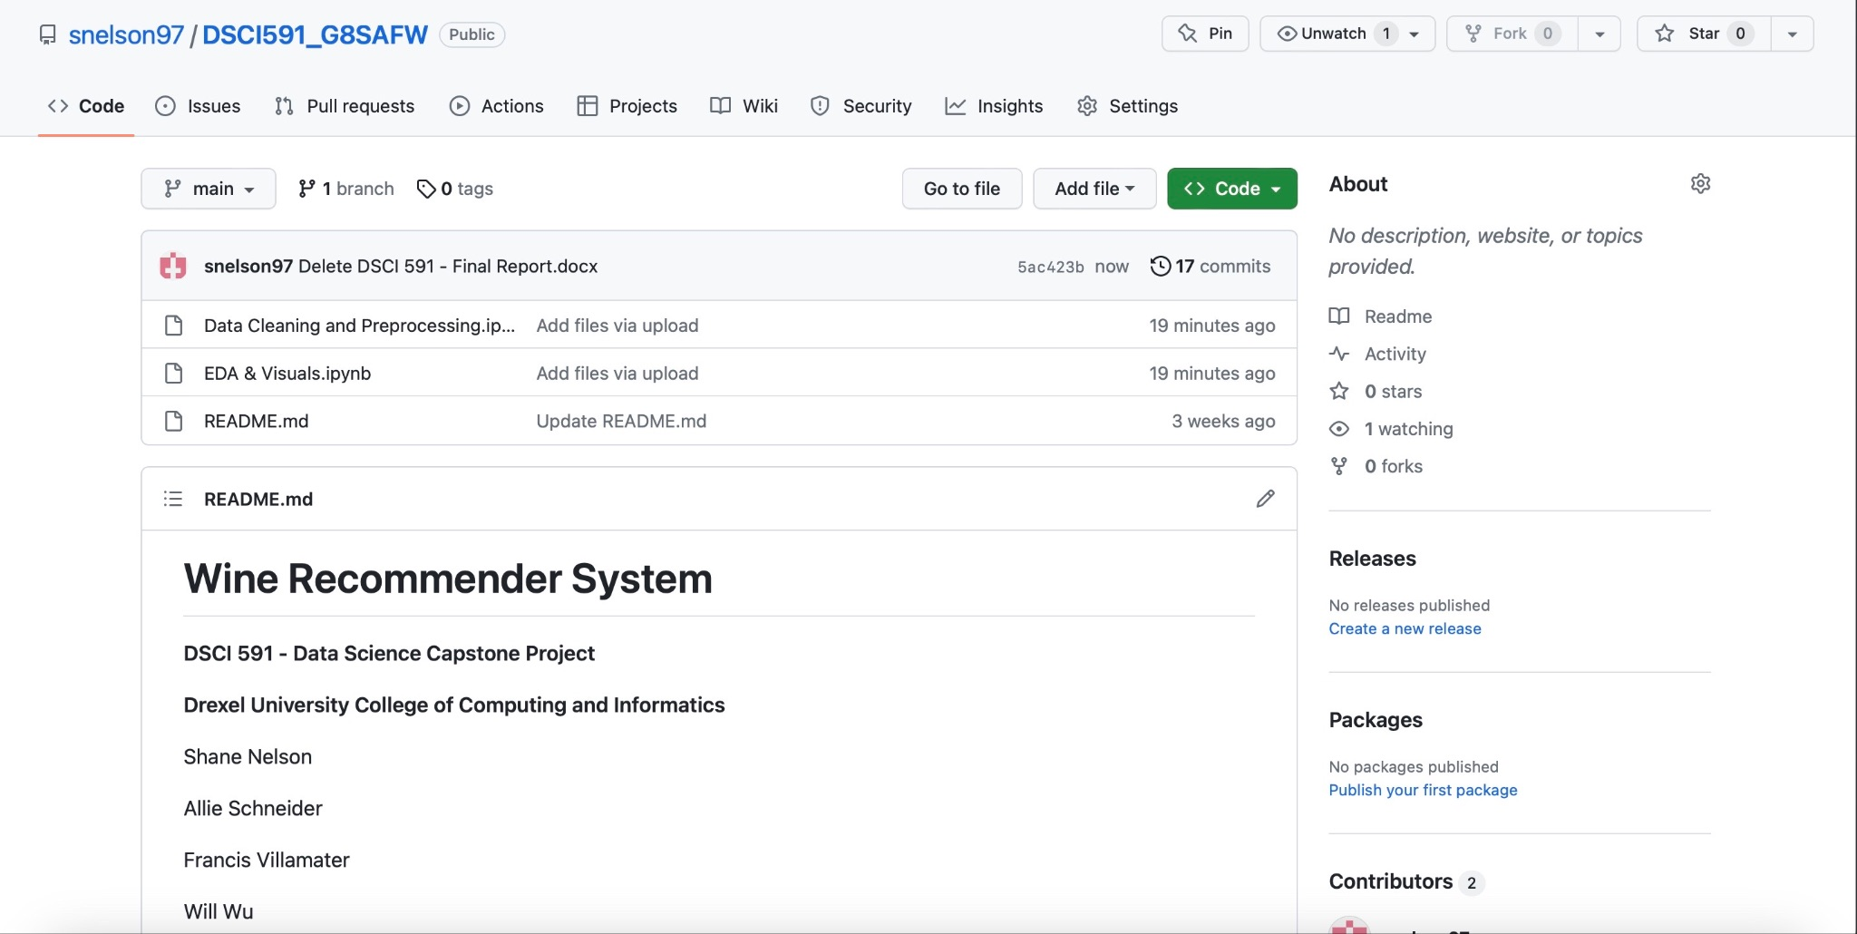
GitHub Repository
README
EDA & Visuals
Data Cleaning and Preprocessing
Notes:
Shane

Slide 14
Next Steps
Create unique data frames based on the type of recommender system
Modeling:
Content-Based Recommender:
Regression
Classification
Similarity-Based
Knowledge-Based Recommender
Constraint-Based (search criteria)
Case-Based
Clustering
Model Evaluation Metrics used to determine best approaches
Notes:
Shane

Slide 15

Summary
Wine Recommender system has value for multiple different user groups
Dataset contains many different features commonly used to characterize wine
Create different types of recommender systems using shared domain knowledge and data science skills
Data has been analyzed and fully prepared for modeling
Notes:
Shane

Slide 16
References
Data source: https://www.kaggle.com/datasets/zynicide/wine-reviews
Github Repository: https://github.com/snelson97/DSCI591_G8SAFW
Notes:
Shane

Slide 17
Thank You
Notes:
Shane

